Slide 1
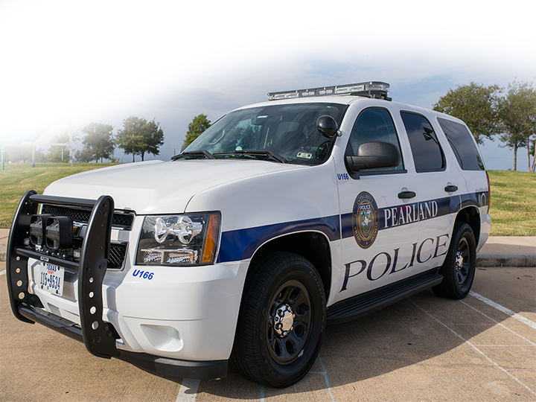
Visual Observer Training
Officer Brandon Karr
City of Pearland, Texas

Slide 2
Visual Observer Definition
A person or persons who’s sole responsibility during a flight operation is to maintain visual line of sight (VLOS) of the sUAS to assist in the safe and legal operation of flight.

Slide 3
Visual Observer’s Role
After take off, keep a direct line of sight with the UAS
Work with the pilot to ensure a safe flight
Keep open communication with the pilot
Identify and mitigate any unsafe conditions
Keep the pilot informed of any obstacles:
Light poles
Wires
Trees
Airplanes / helicopter
Any other objects in the flight path
People
Birds

Slide 4
VO Quiz
A person whose sole task is watching the sUAS to report hazards to the rest of the crew is called
Visual observer
Remote-PIC
Person manipulating the controls
Who is ultimately responsible for preventing a hazardous situation before an accident occurs?
The visual observer (VO)
The Remote Pilot in Command (Remote PIC)
The person manipulating the controls

Slide 5
Near miss with helicopter
Birds and Drones
Drone vs Plane

Slide 6
Scanning for Aircraft/Hazards

Slide 7
Visual Observer Communication
Information needed:
Immediate action
Planes/Helicopters
Unprotected Persons
Birds
Caution
Approaching Obstacle
Losing Line of Sight
Next Visual Observer notification of acquiring line of sight.

Slide 8
VO Communication
Hazard location in relation to the drone
East of the drone, North of the drone, Ect.
VO’s suggested action to avoid collision or violation
Climb, descend, maneuver east, terminate

Slide 9
VO Quiz
The common procedure for scanning for hazards of flight is to:
Scan the air from left to right, quickly multiple times.
Scan the air from right to left in a circular pattern,
Scan the air from center to left, then center to right in sectors, checking each sector carefully
The Visual Observer may use binoculars to assist in the ability to maintain visual line of sight.
True
False

Slide 10
Night sUAS Operations

Slide 11
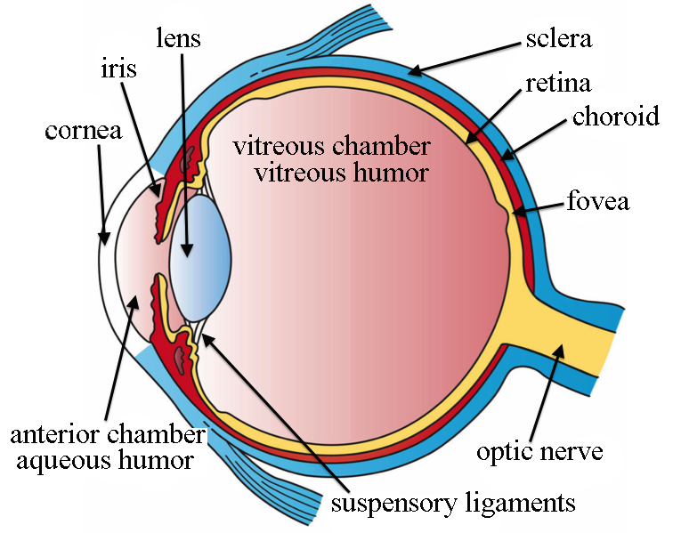
The Human Eye

Slide 12
The Human Eye
As light enters the eye it passes through the lens and strikes the retina. The retina contains millions of Rods and Cones.
Rods
Outnumber Cones 17:1
Used for low light image processing as well as peripheral vision.
Cones
We use cones to see motion, detail, and color.
Cones require a high level of illumination to function.
Decrease in density from the center of the eye to the edge of the retina.
The fovea is completely covered in only cones.

Slide 13
VO Quiz
The Cones in your eye are used for:
Detail
Peripheral images
Low light images
The Rods in your eye are used for:
Low light image processing
Detail
Color

Slide 14
Factors that Affect Night Vision
Night Vision Processing
Two blind spots
Lack of color vision
Reduced acuity
Reduced depth perception
Night myopia
Visual hypoxia
Night blindness
Effects of aging
Carbon monoxide, alcohol, drugs, fatigue, smoking

Slide 15
Night Vision Processing
Process requires about 30 min
Rods become adjusted to darkness
Off-center viewing important during night flights
Smoking, carbon monoxide, hypoxia, certain drugs adversely affect night vision
Avoid bright lights to preserve night vision
Red light preserves night vision but severely distorts colors

Slide 16
Two Blind Spots
Physiological blind spot
Occurs due to the Optic nerve bundle entering the eye called the Optic Disk
Not observed due to the other eye compensating.
Central blind Spot
Due to there not being any rods in the Fovea
Look approximately 15 degrees off to see detail.

Slide 17
VO Quiz
The two blind spots in the eye are due to the optic nerve and the lack of rods in the fovea
True
False
Red light preserves night vision
True
False

Slide 18
Lack of Color Vision
Due to the lack of light, rods cannot function properly. Thus, the ability to see color is decreased

Slide 19
Reduced Acuity
Central vision blindness at night
High rod-to-optic nerve fiber ratio reduces acuity
Again due to the ability to process light

Slide 20
Night Myopia
Near sightedness occurs during dark focus
Periodically change focus distance

Slide 21
VO Quiz
At night your ability to see color is:
Increased
Decreased
Neither
Night Myopia is the night effect on the eye that causes near sightedness.
True
False

Slide 22
Visual Hypoxia
The retina of the eye is more sensitive to hypoxia than any part of our body
One of the first symptoms of hypoxia is a decrease in night vision
Effects most noticeable starting at 5000’ above ground level to which you are acclimated
Smokers are much more susceptible to hypoxia due to the build-up of carbon monoxide in their blood

Slide 23
Night Blindness
Functionally blind due to pigment deficiency in rods
Night blindness induced within 60 days on diet lacking vitamin A

Slide 24
Effects of Aging
Pupil size decreases
Range of eye focus is reduced
Visual acuity is reduced
Color discrimination becomes more difficult
It takes longer to process visual information in general
Sensitivity to glare increases
Takes longer to read under dim light conditions

Slide 25
Night Illusions & Limitations
Illusions
Autokinesis (objects appear to shift)
False reference (stars or lights near horizon)
Venus and sirius (false aircraft)
Night myopia (dilation, inability to focus)
Somatogravic (acceleration with pitch)
Limitations
Night blind spot (rods & cones, stars, etc)
Light to dark adaptation (30min)

Slide 26
Focused Scan Problems at Night
Night blind spot
center portion of eye is blind at night
Night Scan
look 10-15⁰ away from what you try to see
night vision is affected by altitude
drugs, alcohol, smoking and fatigue adversely affect night and day vision

Slide 27
VO Quiz
The night illusion autokinesis is when objects appear to shift when the observer stares directly at the object.
True
False
The night illusion False Reference is when the observer cannot discern where the horizon is located due to ground lighting creating the illusion to be stars.
True
False

Slide 28
End
Questions, Comments, Concerns
281 825 2060
bkarr@pearlandtx.gov

